Slide 1
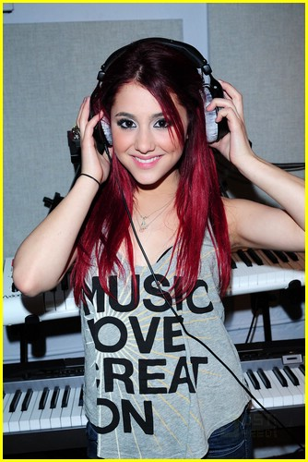
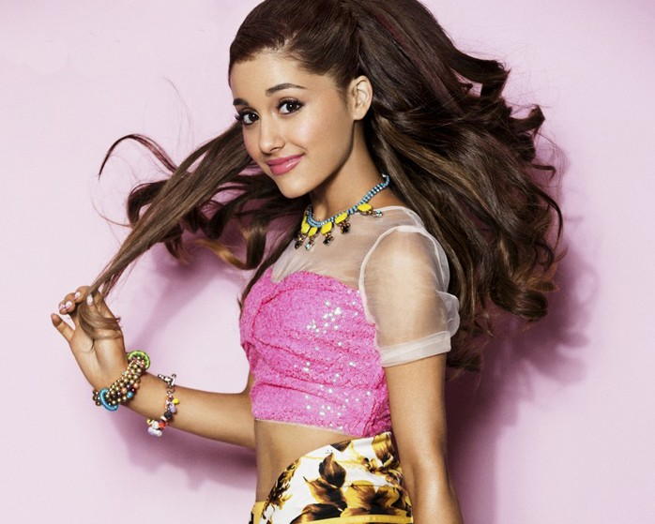
MY FAVOURITE FAMOUS:

Slide 2
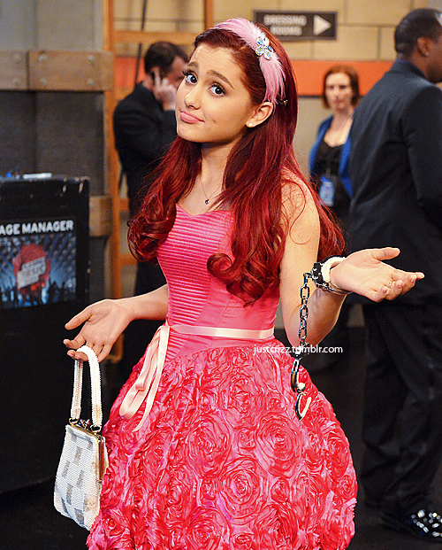
Ariana Grande is an actress, singer and songwriter was born on June 26, 1993 in Florida.

Slide 3
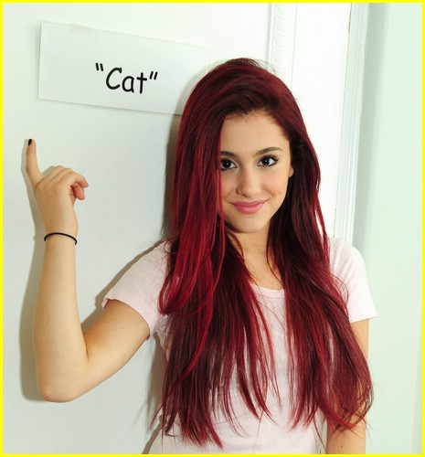
Ariana in victorious was a girl with fair skin, and red wavy hair, tall, cute and pretty, in the series was called Cat.

Slide 4
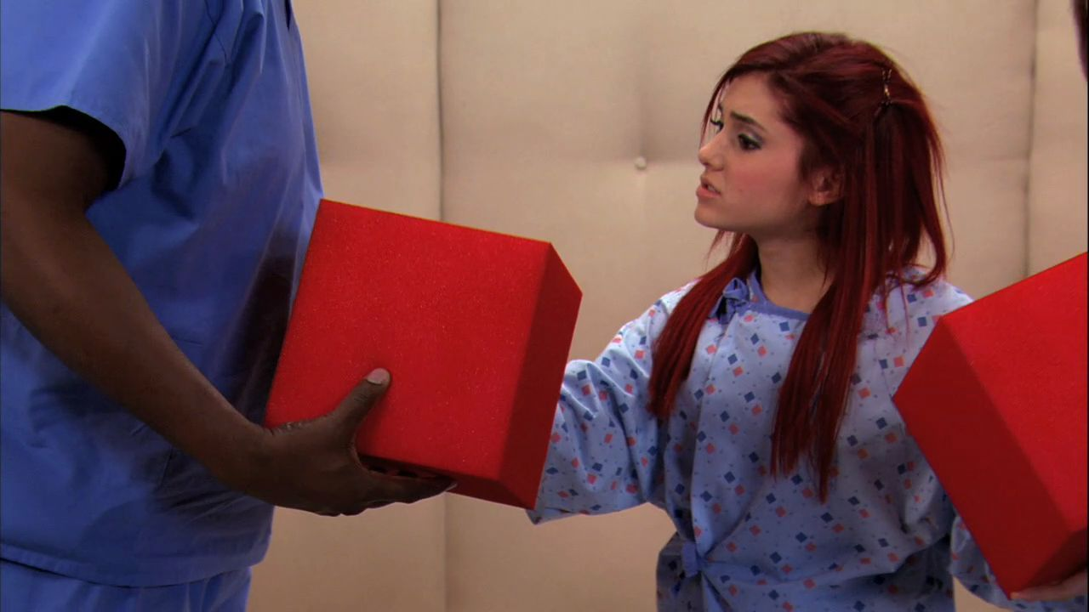
Ariana Grande in victorious was a funny girl, friendly, cheerful, and a little silly, a great singer and dancer.

Slide 5
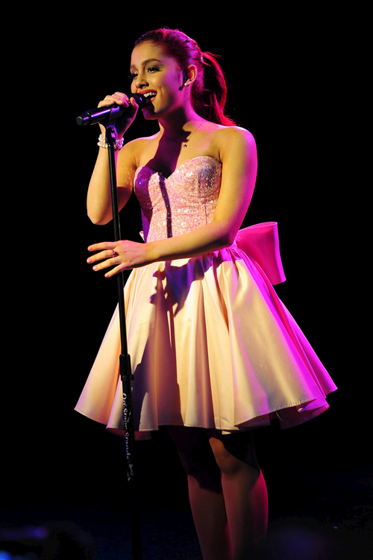
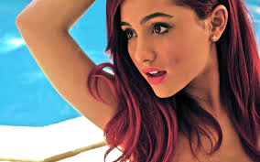
I chose Ariana Grande because for me it is very good singer, is beautiful, funny, by his nature, I like her clothes and her hair so crazy.

